Slide 1


DIABETES PREDICTION
Subject : Machine Learning
Lecturer : Him Soklong
Presented By Group 2
Ly Seavmey
Chamroeun Vichita
1

Slide 2
CONTENTS
Problem Statement
Project Workflow
Exploratory Data Analysis (EDA)
Methodology
Logistic Regression Model
Random Forest Model
Comparative Analysis
Challenges & Lessons Learned
Conclusion
2

Slide 3
PROBLEM STATEMENT
The objective of this project is to build machine learning models that predict whether a patient has diabetes based on medical information and compare the performance of Logistic Regression and Random Forest.
Problem Type: Classification
3

Slide 4
PROBLEM STATEMENT
Dataset Description: This Dataset has 14 features and 1000 rows
Source: Kaggle
Dataset: Diabetes Prediction Dataset
Target Variable (CLASS):
0 = Non-Diabetic
1 = Prediabetic
2 = Diabetic
Key Features: HbA1c, BMI, AGE, Glucose, Urea, Cr (Creatinine), Chol, TG, HDL, LDL, VLDL, Gender.
4

Slide 5
PROJECT WORKFLOW
Preprocessing
StandardScaler,LabelEncoder
4. Hyperparameter Tuning
GridSearch
1. Load Dataset
2. EDA & Cleaning
5. Model Evaluation
Acurracy,Precision, Recall, F1-Score
6. Model Deployment
FastAPI, Streamlit
5

Slide 6
EXPLORATORY DATA ANALYSIS (EDA)
Features
Column | Data type | Description
ID | int64 | Unique patient identifier
No_Pation | int64 | Patient number/record ID
Gender | object | Male or Female
AGE | int64 | Patient's age
Urea | float64 | Blood urea level
6

Slide 7
EXPLORATORY DATA ANALYSIS (EDA)
Features
Column | Data type | Description
Cr | int64 | Creatinine level
HbA1c | float64 | Average blood glucose level over the past 2–3 months
Chol | float64 | Cholesterol level
TG | float64 | Triglyceride level
HDL | float64 | High-density lipoprotein ("good" cholesterol)
7

Slide 8
EXPLORATORY DATA ANALYSIS (EDA)
Features
Column | Data type | Description
LDL | float64 | Low-density lipoprotein ("bad" cholesterol)
VLDL | float64 | Very low-density lipoprotein
BMI | float64 | Body Mass Index
CLASS | object | Target variable (Diabetic status)
8

Slide 9
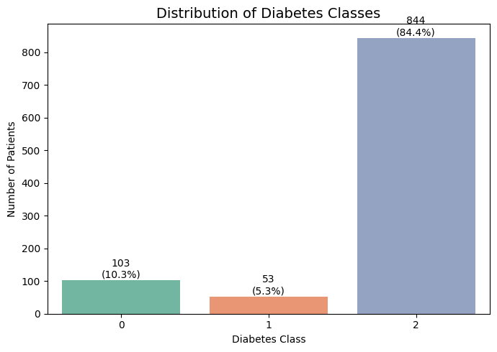
EXPLORATORY DATA ANALYSIS (EDA)
How many patients are in each diagnosis Class ?
CLass 0 : Non-Diabetic
Class 1 : Pre-Diabetic
Class 2 : Diabetic
9

Slide 10
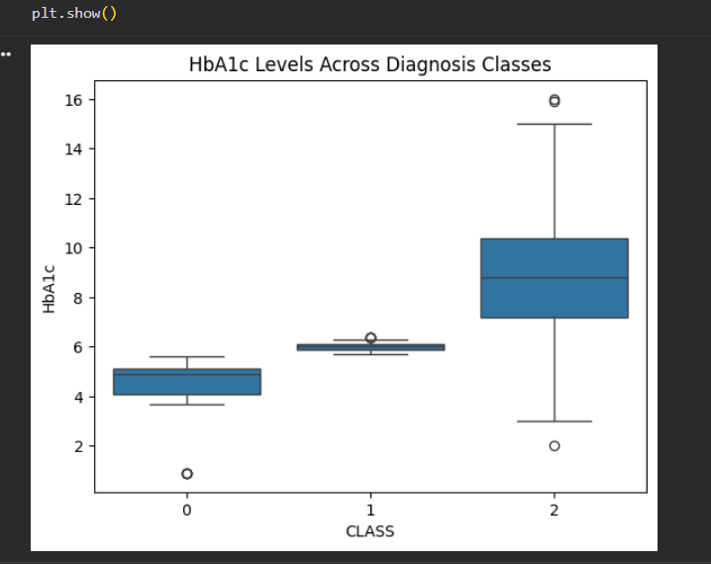
EXPLORATORY DATA ANALYSIS (EDA)
Which HbA1c levels Range belongs to which Class?
Class 0 (Non-Diabetic): between 4.0 and 5.2.
Class 1 (Prediabetic): around 5.7 to 6.3.
Class 2 (Diabetic): between 7.0 and 10.5 (reaching up to 16).
10

Slide 11
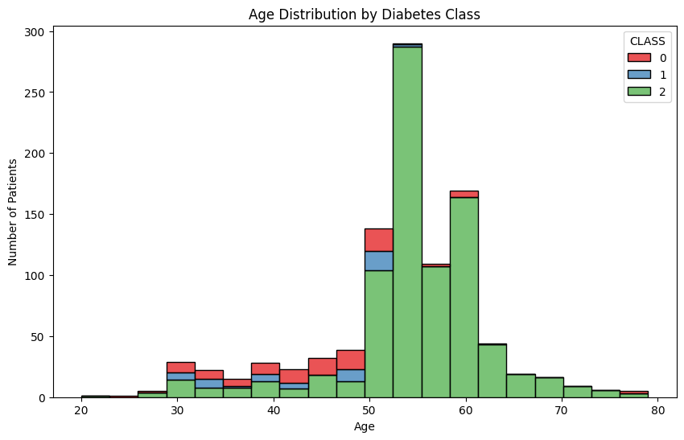
EXPLORATORY DATA ANALYSIS (EDA)
Which patient's age risk of having diabetes?
Patients in 50–60 year olds mostly have Diabetes very few patients under 30 or over 70.
11

Slide 12
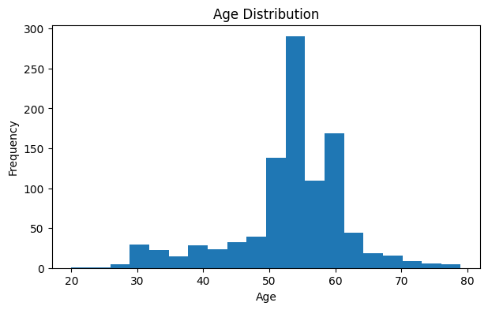
EXPLORATORY DATA ANALYSIS (EDA)
Which patient's age risk of having diabetes?
Data is heavily concentrated between ages 50–60 (peaking around 53–55); under 30 and over 70 are rare.
12

Slide 13
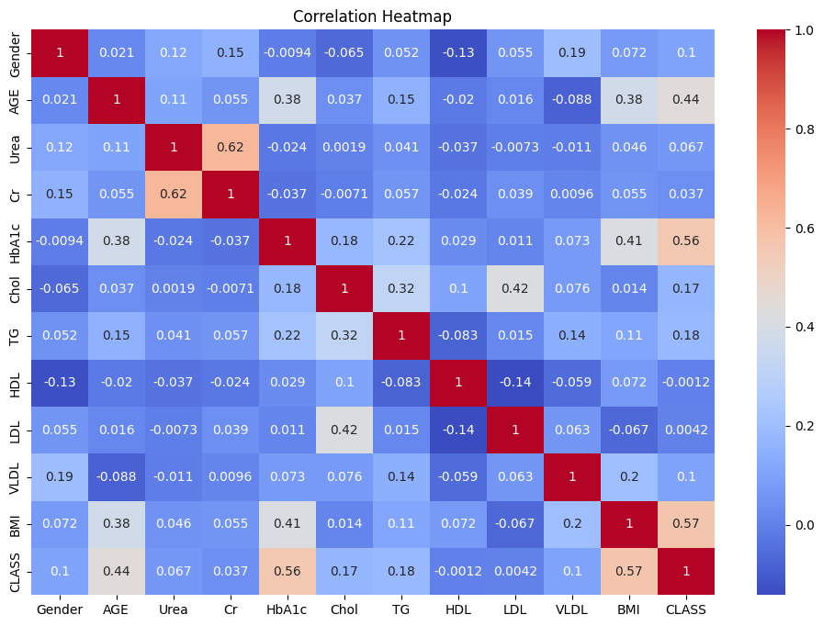
EXPLORATORY DATA ANALYSIS (EDA)
Which features are most strongly tied to diabetes?
BMI (Body Mass Index) — Correlation: 0.57
HbA1c (%) — Correlation: 0.56
AGE — Correlation: 0.44
13

Slide 14
4. METHODOLOGY
Project Goal: Predict a patient's diabetes status (Non-diabetic, Prediabetic, or Diabetic) using supervised machine learning algorithms to classify the CLASS variable.
Data Cleaning & EDA: Trimmed whitespace in categorical features and analyzed distributions & boxplots.
Preprocessing: Encoded categorical variables, dropped non-predictive ID columns, and performed an 80/20 train-test split.
Model Training & Tuning: Trained Logistic Regression and Random Forest models, optimizing hyperparameters with GridSearchCV.
Evaluation: Assessed model performance using Accuracy, Precision, Recall, and F1-score.
14

Slide 15
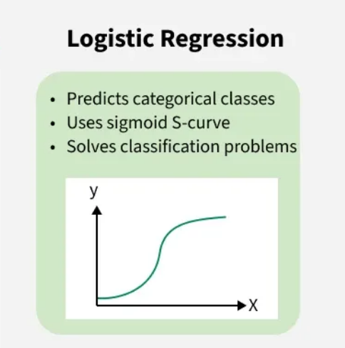
LOGISTIC REGRESSION MODEL
It predicts the probability that a patient belongs to a specific diabetes class based on the input features and uses the sigmoid (logistic) function to convert the prediction into a probability between 0 and 1. It is simple, fast, and easy to interpret.
15

Slide 16
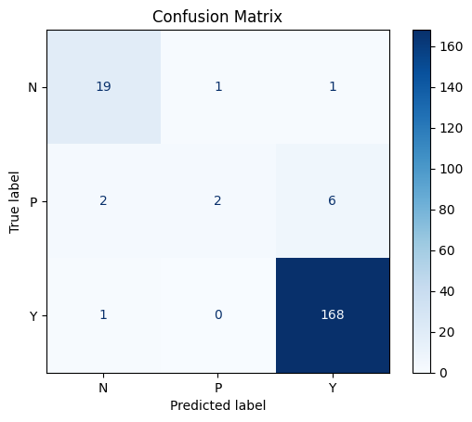
LOGISTIC REGRESSION MODEL
The Logistic Regression model correctly classified most patients, especially the Diabetic (Y) class. However, it had difficulty distinguishing Prediabetic (P) patients from Diabetic (Y) patients, leading to several misclassifications.
16

Slide 17
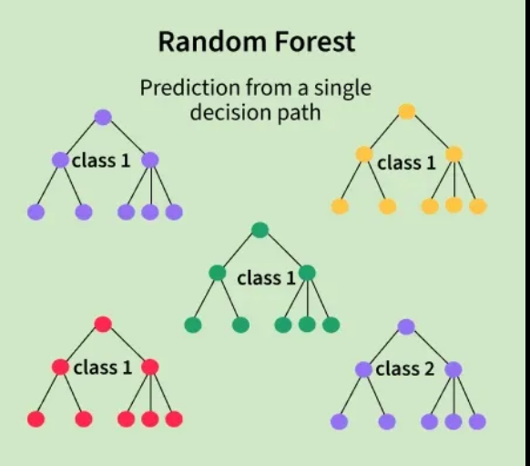
RANDOM FOREST MODEL
Random Forest builds multiple decision trees and combines their predictions using majority voting to make the final classification.
It is highly accurate, handles complex relationships in the data, is resistant to overfitting, and performs well with medical datasets.
17

Slide 18
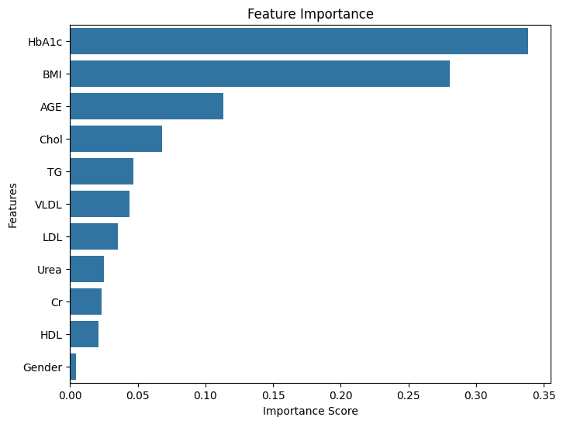
RANDOM FOREST MODEL
Which features are most strongly tied to diabetes?
HbA1c was the most important feature, followed by BMI and Age. Gender had the least influence. This indicates that blood sugar level (HbA1c), body mass index, and age were the strongest predictors of diabetes in this dataset.
18

Slide 19
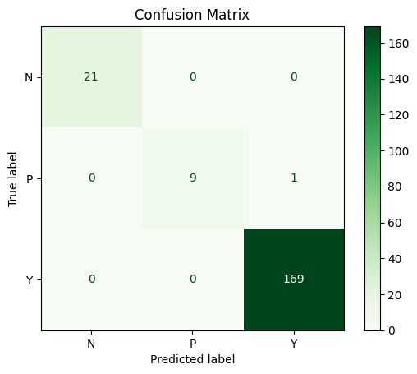
RANDOM FOREST MODEL
Random Forest
The Random Forest model achieved nearly perfect classification. It correctly predicted every Non-diabetic and Diabetic patient and made only one error by classifying a Prediabetic patient as Diabetic.
19

Slide 20
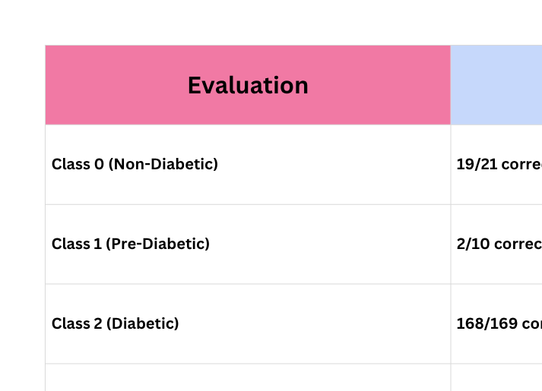
COMPARATIVE ANALYSIS
Confusion Matrix comparison
20

Slide 21
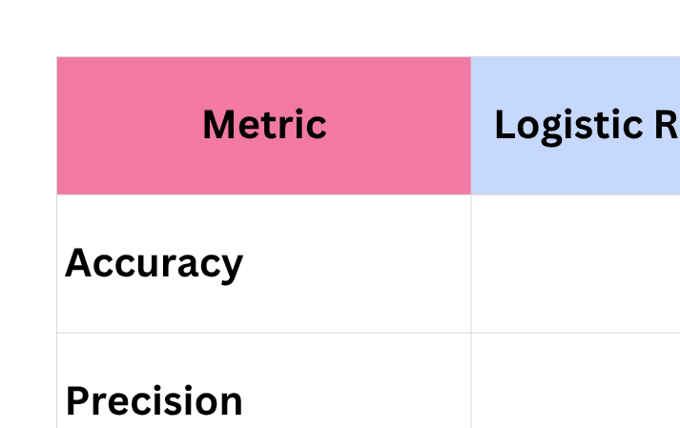
COMPARATIVE ANALYSIS
21

Slide 22
CHALLENGES & LESSONS LEARNED
During the project, some challenges were encountered. The dataset contained extra spaces in the CLASS and Gender columns, which had to be encoded before training the models. It was also important to use different preprocessing steps for each algorithm, such as scaling the data for Logistic Regression but not for Random Forest.
This project helped improve skills in data preprocessing, exploratory data analysis, model training, hyperparameter tuning, and model evaluation.
22

Slide 23
CONCLUSION
Both models performed well, but Random Forest achieved the best results, with an accuracy of 99.50%, compared to 94.50% for Logistic Regression.
Based on the results, Random Forest is the recommended model for this diabetes prediction task because it provides higher accuracy and better overall performance. The project also demonstrates how machine learning can be used to support early diabetes prediction using patient health data.
23

Slide 24

THANK YOU
VERY MUCH
24

